Slide 1

How to gain
control of your
free time
——Laura Vanderkam
Speaker : Wen Jie

Slide 2
01
INTRODUCTION
CONTENT
02
SUMMARY
03
RESPONSE

Slide 3
01
INTRODUCTION

Slide 4

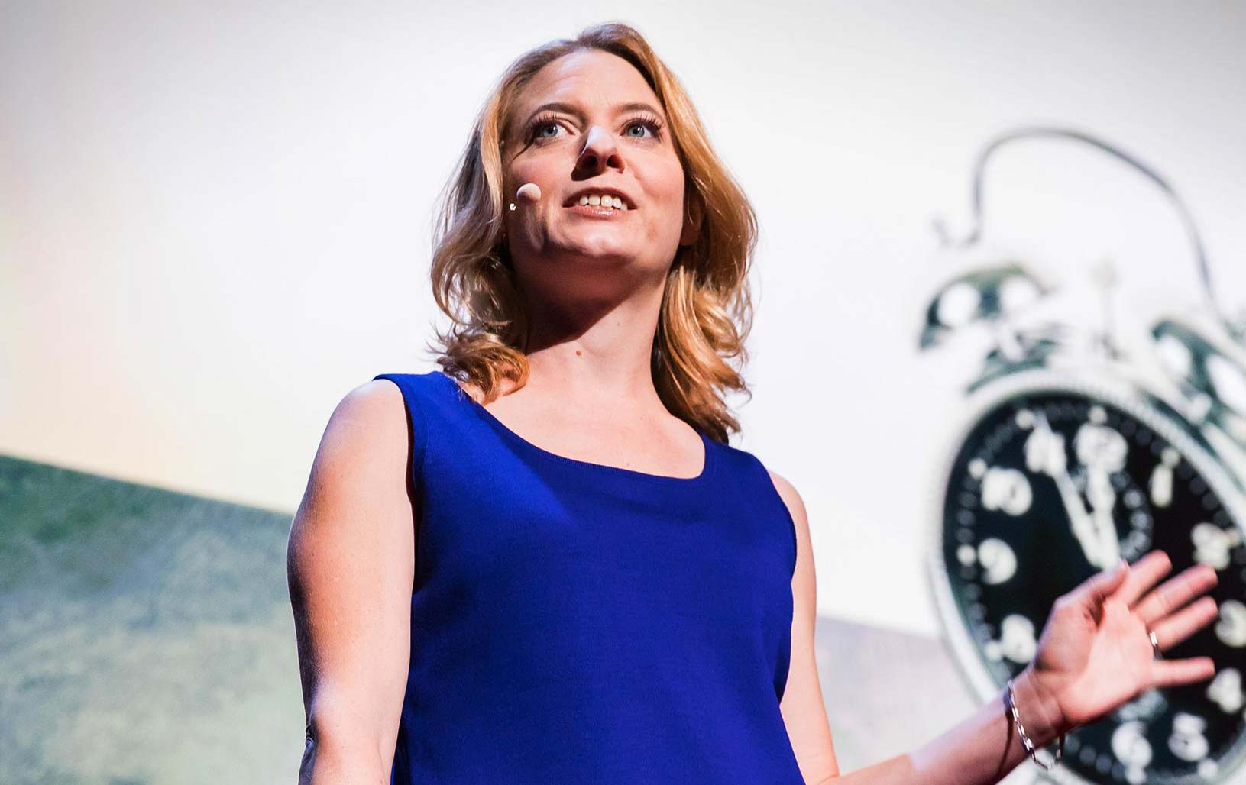
INTRODUCTION
The author of several time management and productivity books
Has appeared on
numerous television programs
Laura Vanderkam
Her work has appeared in publications including The New York Times, The Wall Street Journal, USA Today and so on.
延时符

Slide 5
02
SUMMARY

Slide 6
SUMMARY
Time is highly elastic
Look back at your year
Prioritization
strategies
Imagine the end of the next year
Break them down into manageable steps
Put priorities into action
methods
Make the most of small moments

Slide 7
03
RESPONSE

Slide 8
RESPONSE
MYTHS
Schedule every hour full of work?
You have time for the things you prioritize!

Slide 9
RESPONSE
get the best of
anything
you are doing
with your time

Slide 10
RESPONSE
Cycled to school as fast as possible
Cycled to school at a leisurely pace
Be stopped at the red lights
Enjoy nature
Be caught up with slower cyclists
Be frustrated with the time wasted
relaxed and ready for the day
more sweat, frustration, and muscle pain

Slide 11
在此输入标题文本
RESPONSE
Make a priority list
will make your life better.
Take time to just be present in the moment and life.

Slide 12
END
THANK YOU

